Slide 1

Tower Hopscotch Design Group 5
Raphael Emberger
Stefan Bösch
Philipp Meier
Nicolas Eckhart

Slide 2
Project Management
Just finished iteration #4
Finish project design, implement game loop and map class capable of loading map from file
Effective time expenditures for iteration #4 in expected ranges
No major changes in the risks
Next up in iteration #5:
UC 1: Play Game implemented (though without some features like upgrading towers)

Slide 3
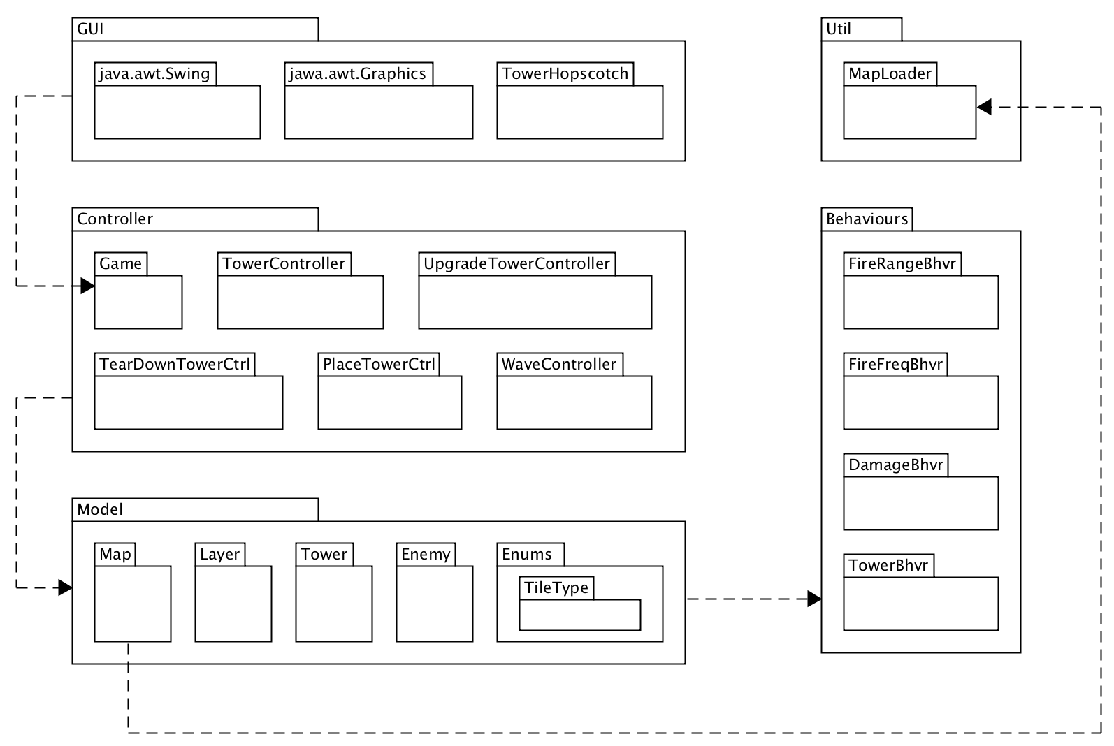
Project Architecture

Slide 4
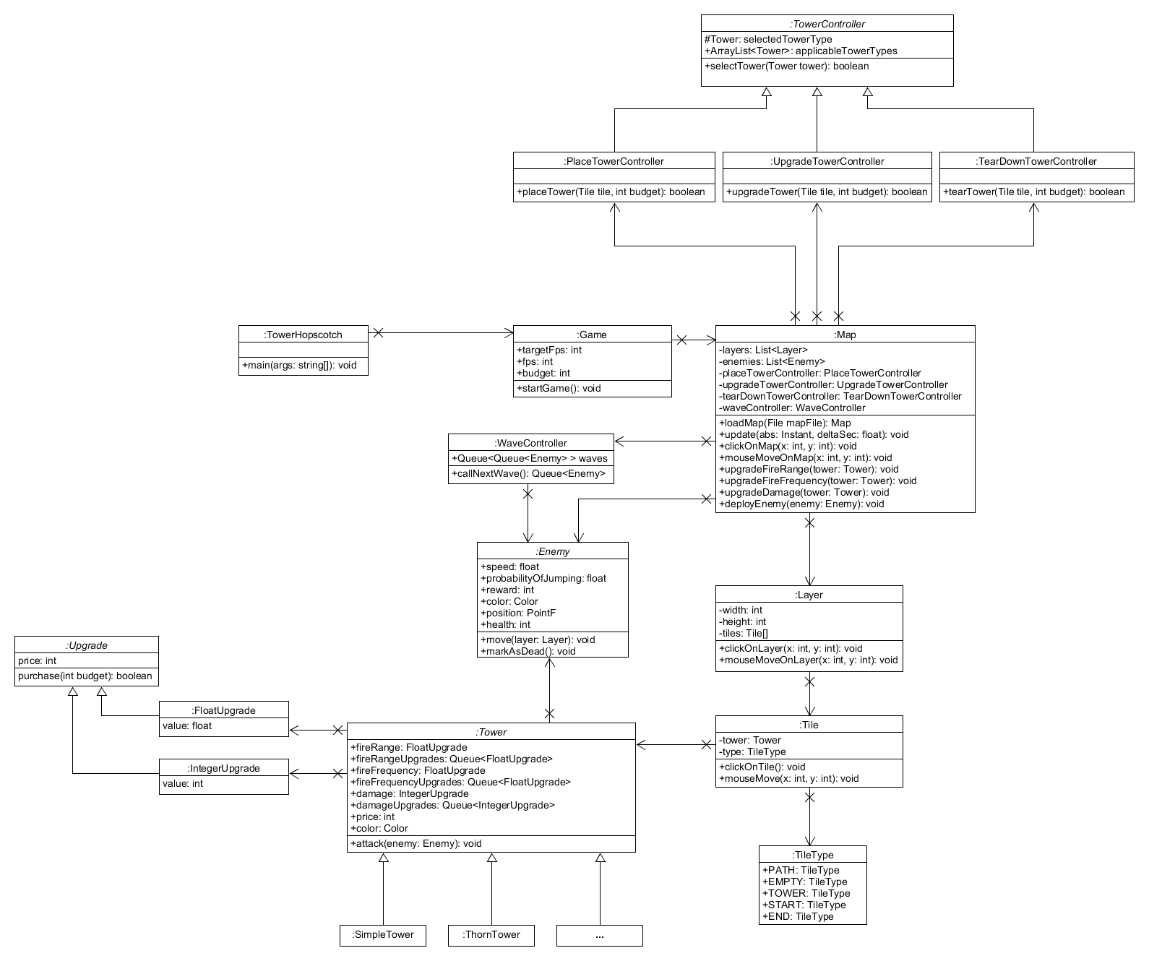
Design Class Diagram

Slide 5
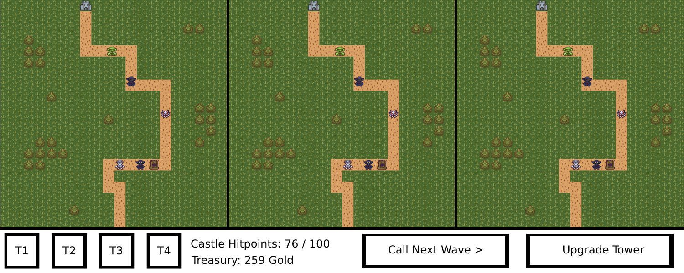
GUI

Slide 6
Questions?

Slide 7
Thanks for your time!
Raphael Emberger
Stefan Bösch
Philipp Meier
Nicolas Eckhart

